Slide 1
Secure Programming
程式安全
Course Outline
Part 1: Software Security and Static Analysis, Dynamic Analysis, and Concolic Analysis
Part 2: Pervasive Problems
Part 3: Features and Flavors
Part 4: Analysis in Practice
交通大學 資訊技術服務中心 黃世昆
skhuang@cs.nctu.edu.tw

Slide 2
About Us
退役、屬於上個世代
  緣起於 1991 年，許多不邀自來的駭客、進入交大資工系系計中網路與系統，受到啟蒙。
  20 years of software quality research
    Bridging between software quality and software security
有許多出色的學生
  HITCON wargame 3rd place 2011
  HITCON wargame 1st place, 2012,2013
  Joint team for HITCON CTF 2014, 9th place (Taiwan first)
  Joint team for DEF CON CTF 22(2nd), 23(4th) , 24(4th) place
  Joint team for Honeyme 2015 in 1st place and in 2nd place

Slide 3
Motivation: Why Secure Programming ？
Yet Another Security Course ?
Spectrum of Information Security

Slide 4
Information Security Related Courses
[DS] Data Security – Encryption/Public-key/Key Management Protocols
[NS] Network Security – Security Protocols
[SS] System Security – William Stallings’s
  Intruders/Viruses
  Firewalls
[SS2] Software Security – Building Secure Software

Slide 5
Data Security Course
Data Security 80%
Network Security 15%
System Security 4.9%
Software Security 0.1%

Slide 6
Network Security Course
Data Security 56%
Network Security 30%
System Security 13%
Software Security 1%

Slide 7
System Security Course
Data Security 10%
Network Security 20%
System Security 60%
Software Security 10%

Slide 8
Software Security Course
Data Security 2%
Network Security 8%
System Security 20%
Software Security 70%
  Reliable Software
    Secure Software Development
  Secure Programming

Slide 9
Background

Slide 10
Traditional Engineering and Software Engineering
Traditional Engineering
  Destructive Test
    Bridge and Building: Wind Tunnel, Earthquake Test
    Metal: Pressure Test
  Or, Fall Down for the case of Tacoma Narrows Bridge
    A 600-foot section falling into the water in November 7, 1940
    in Puget Sound, near the city of Tacoma, Washington, the bridge had only been open for traffic a few months.
    the first suspension bridge collapsed due to wind-induced vibrations
Software Engineering
  Fragile software
  Not with security in mind, but reactive technologies, e.g. firewall

Slide 11
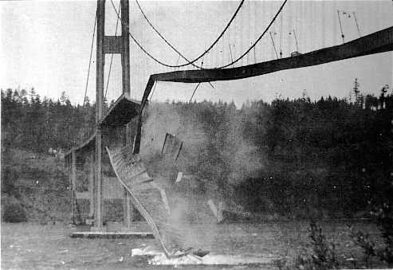
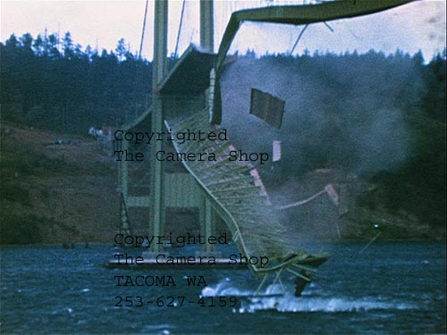
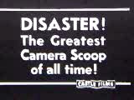
A 600-foot section of the Tacoma Narrows bridge crashes
http://www.enm.bris.ac.uk/anm/tacoma/tacoma.html

Slide 12
Seven Best Practices: Touchpoints
Work Security Engineering into
  Requirements
  Architecture
    Architecture Risk Analysis (2)
  Design
  Coding
    Code Review with Static Analysis (1)
  Testing
  Validation
  Measurement
  Maintenance

Slide 13
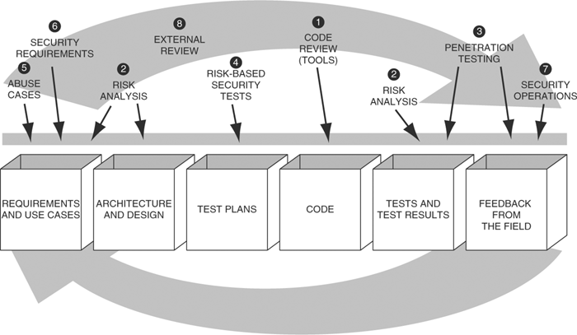
Software Security Touchpoints

Slide 14
Code Review
Focus on Implementation Bugs
  Notorious buffer overflow
    Misuse of vulnerable APIs (e.g., gets(), strcpy(),…)
  Manually or by Static Analysis tool
  What the bug
  How to correct the bug

Slide 15

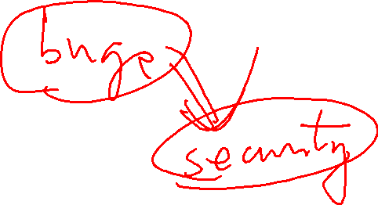

Software Errors
Two decades of buffer overflow vulnerabilities
  1988 Morris worm
    Internet programming community aware
      Buffer Overflow could lead to security breach
  2004, Buffer overflow still the number one cause o security problem by the CVE (common vulnerabilities and exposures project)

Slide 16
Software Engineering and Worms
1968 (conference on software crisis after IC invention, with more complex software)
1988 (Nov 2) Internet Worm
2001 (July 19) Code Red Worm (after 1988)
2003 (Aug 11) Blaster Worm (impact MS)
2005
  Worms Anywhere and Anytime
  Microsoft Software auto-updates more frequently
2011 (Sep 1) Stuxnet (impact nuclear power plant)

Slide 17
Course Objectives
Use static analysis tools to identify coding errors before they can be exploited
Introduce Concepts
  Software Security
  Static Source Code Analysis
  Dynamic Analysis
  Concolic Analysis

Slide 18
Part Ia: Software Security and Static Analysis
The Software Security Problem
Introduction to Static Analysis
  Introduction and static tools survey
Static Analysis as Part of the code Review Process
  How to effectively use the tools
Static Analysis Internals
  How static analysis tools work

Slide 19
Software Security Problem
Defensive Programming is not Enough
Security Features != Secure Features
Software Quality and Software Security
  Testing Specified v.s. Unspecified Features

Slide 20
Part Ib: Software Security and Dynamic Analysis
Run-time Error Detections
  Memory Leak Detection
  Pointer Access Range Detection
  Integer Security Detection
Bug Localization and Forensics
  Deduce/Induce faults from failed outputs
  Exploiting Bug from inspected Faults

Slide 21
Part Ic: Software Security and Concolic Analysis
Introduction to Symbolic Evaluation and Concrete Evaluation
Combining Symbolic and Concrete Evaluation (Concolic)
Explicit Software Model Checking

Slide 22
Part II: Pervasive Problems
Handling Input
  Tainted Input Analysis
Buffer Overflow
Bride of Buffer Overflow (Integer Security)
Errors an Exceptions
  Connections between error handling and recovery
  Approaches to logging and debugging

Slide 23
Part III: Features and Flavors (Guidance for Secure Coding)
Web Applications
XML and Web Services
Privacy and Secrets
Privileged Programs

Slide 24
Part IV: Static/Dynamic/Concolic Analysis in Practice
Security Analysis for Java
Security Analysis for C

Slide 25
Tools
Static Analysis Tools
  MOPS, BLAST, Fortify SCA
Dynamic Analysis Tools
  Fuzz Test
  CRED, Valgrind (memcheck)
Concolic/Symbolic Execution Tools
  Cute, JCute, Alert
  S2E
ShellCode Tool
  Metasploit
  Metasplitable

Slide 26
Course Activities and Grading
Attending Class Lectures (Joining Discussion) 10%
Exam (10%)
CTF (capture the flag) and Labs (70%)
Bug bounty and Developing or Automating the finding of Real Exploits (20%)

Slide 27
P1: Searching for Potentially Exploitable Bugs
Static Analysis
  PREFAST , SLAM, BLAST, CQUAL
Dynamic Analysis
  Fuzzing (zzuf, peach, afl)
    Unstructured Fuzzing
    Structured Data Fuzzing
  Conclic Fuzzing (angr, klee, s2e)
  Fuzzing with Taintness Analysis

Slide 28
P2: Converting Bugs into Vulnerabilities
Failure Analysis (bug forensics)
  Memcheck (valgrind plugin, ASAN)
  Crash Detection/Recovery (!exploitable )
  Fault Localization (delta-debugging)
  Dynamic Tainted Analysis

Slide 29
P#: Mitigations
Off-by-one Exploit
Nonexecutable Statck/Stack and Heap integrity check
  Return-to-libc
  Return-oriented programming
Address-space randomization
  Searching for fixed entry points

Slide 30
P3: Exploit Development
Testing Exploitability
  Tainted Path Analysis
  Controlling Crash/Tainting
Shell Code Forging
  Metasploit
Plug-into Worm Kit/Take a Botnet
Command/Controlling Botnet

Slide 31
Other References
Robert C. Seacord, “Secure Coding in C and C++”, Addison-Wesley, 2005
  http://www.cert.org/books/secure-coding/
Michael Howard and David LeBlanc, “Writing Secure Code “, 2nd Edition, Microsoft Press, 2003,.

